Slide 1
Global Terrorism Data Observations
Paxson, Andrew T. ISYS 4293, Sec-002

Slide 2
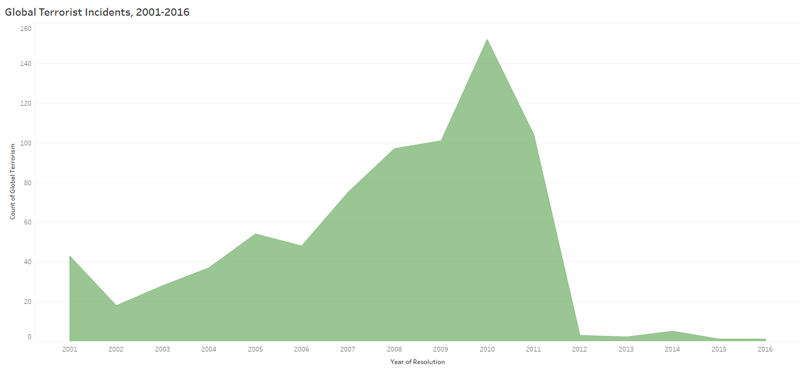
In 2001, 43 Incidents of Terror were Accounted For: The data peaks in 2010 with 152 incidents – a 353% increase across 9 years As of 2016, only 1 incident was logged – the lowest of the 15 year stretch

Slide 3
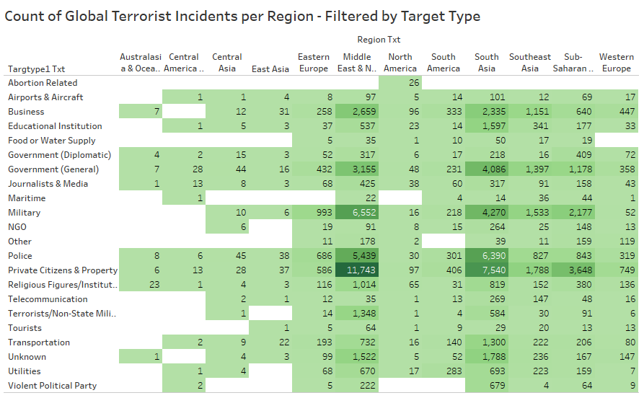
Target Type and Occurrence by Region
Important to note: the only region that had occurrences of terror related to Abortion was North America – this type of incident was notably absent from all other territories
The highest count comes from the combined Middle East and North Africa: 11,743 incidents
This cluster of attacks was made on private citizens and property

Slide 4
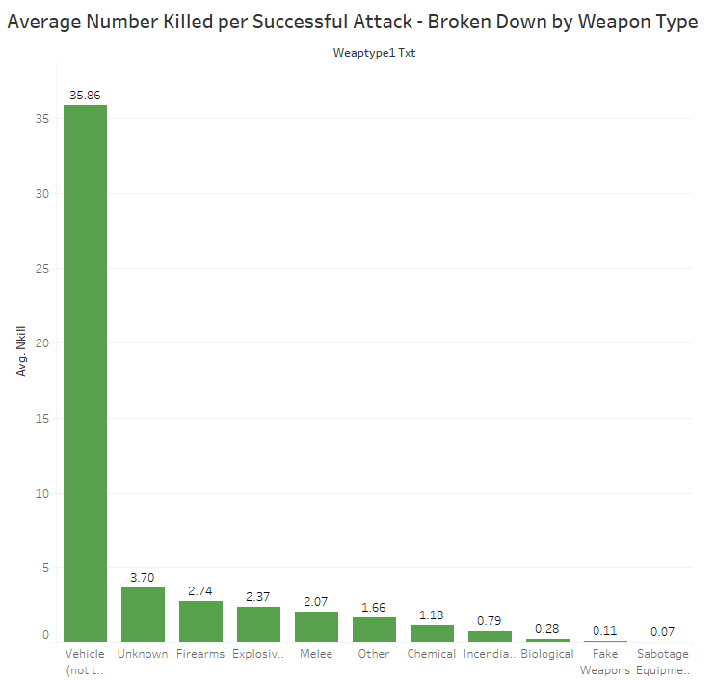
Breakdown by Weapon of Attack
Per successful attack, the most lethal weapon present in the data is vehicles – presumably including airplanes
Vehicle attacks had an average fatality rate of nearly 36 persons, a 969% increase over the next highest (unknown)

Slide 5
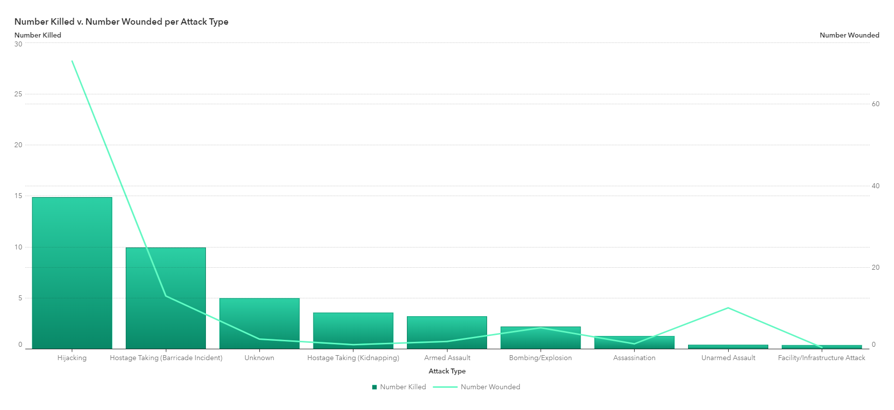
Casualty Breakdown per Attack Type
Hijackings boasted both the highest number killed (14.86) and wounded (70.56), followed sharply by hostage incidents
Unarmed Assault is a point of interest: the data shows that the attack type rarely ended in a fatality, but wounded approximately 10.14 persons per incident

Slide 6
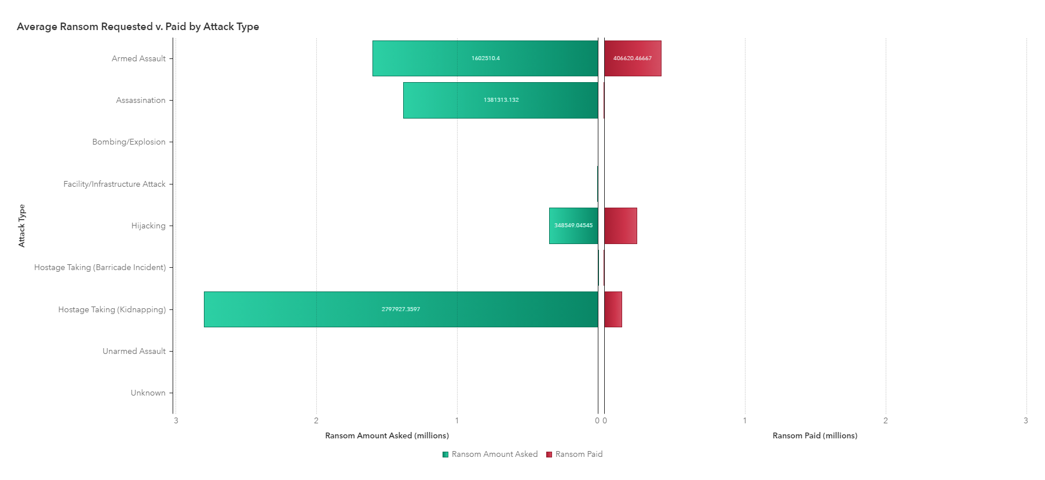
Ransom Requested v. Ransom Paid
Certain attacks are often leveraged through ransoming (hostage taking, armed assault)
Incidents of Hostage Taking – on average – request $2,797,927, but are only paid $125,531, a discrepancy of $2,672,396

Slide 7
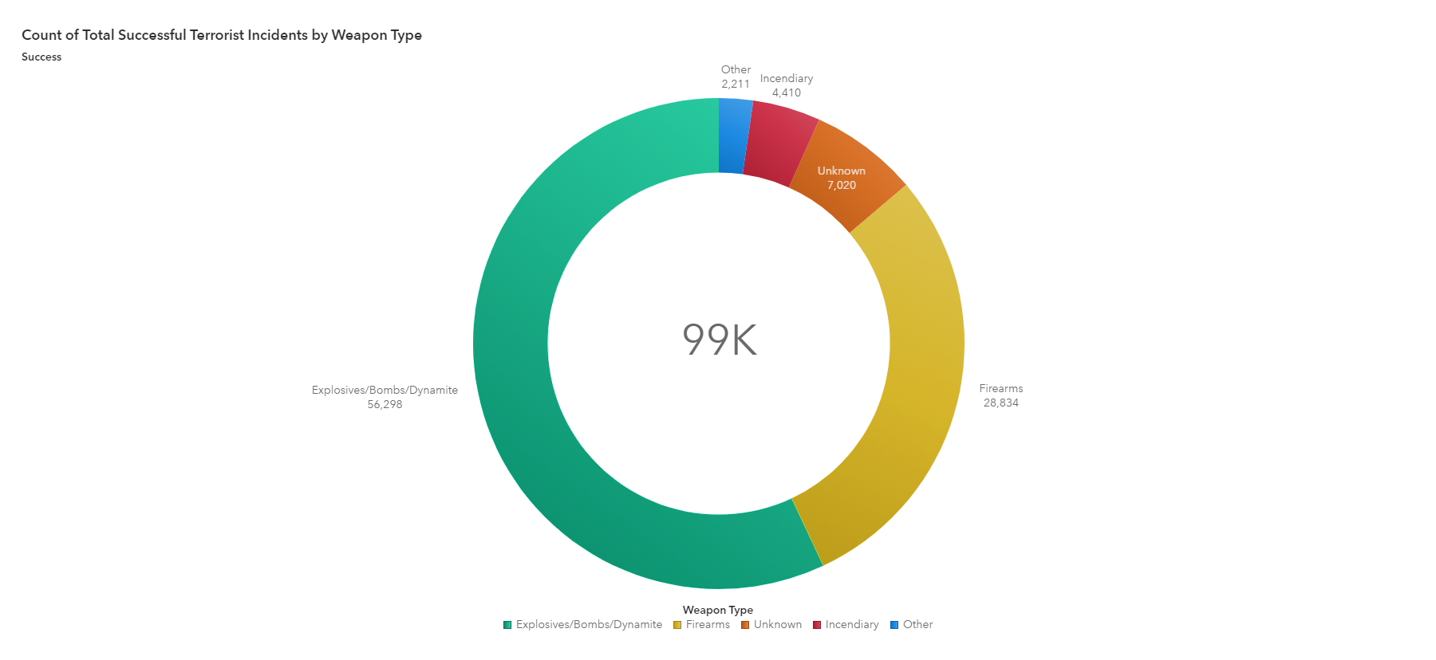
Successful Incidents by Weapon Type
Explosives/Bombs/Dynamite leads with 56,298 total occurrences – more than half of the total
This is followed by firearms (28,634), unknown (7,020), incendiary (4,410) and other (2,211)

